Slide 1
Illusionist’s Shipping Manifesto
AKA
Why I think Vik x K should exist in more brains than mine
I’m so sorry
(No I’m not)

Slide 2
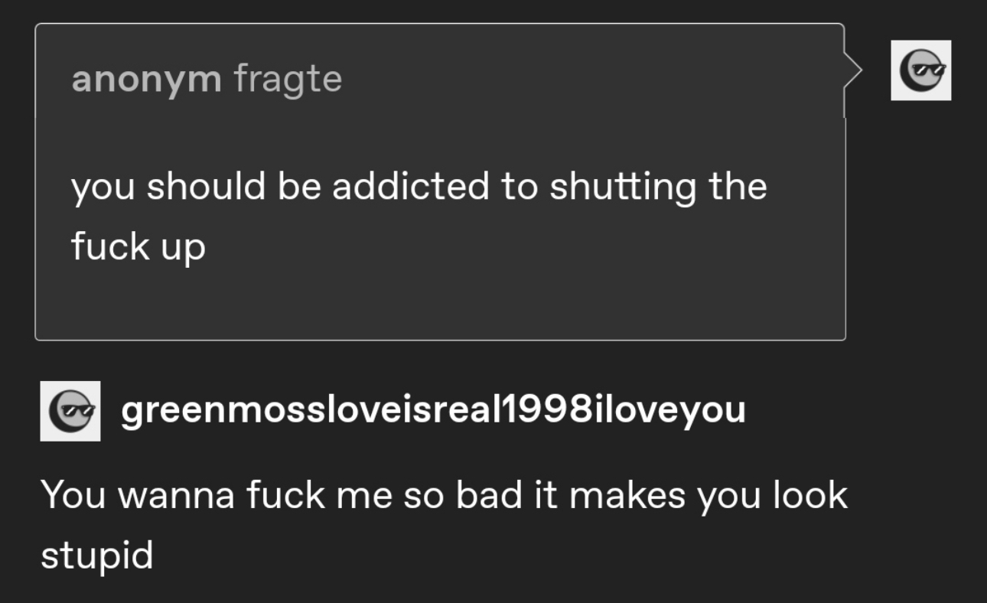
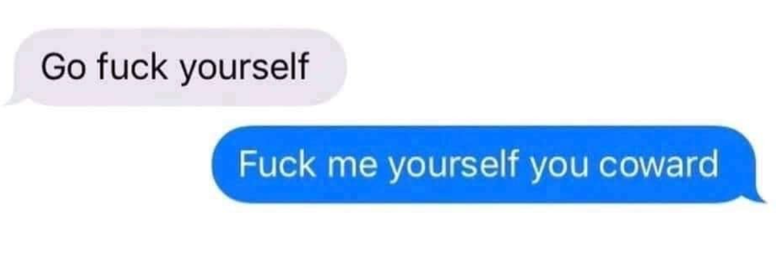
Table of Contents
Thematic Connections
Perception (Seeing)
Perception (Being Seen)
The Intersection
Personal Connections
Freaks (Affectionate)
Dependency (Contrast)
The Interaction
Relationship Analysis
Moirails (Understanding)
Blackrom (Trust)
Concupiscent (Carnal)
Mildly NSFW Interlude
Charm Analysis
Why They Matter
Foreshadowing is a literary device in which-

Slide 3
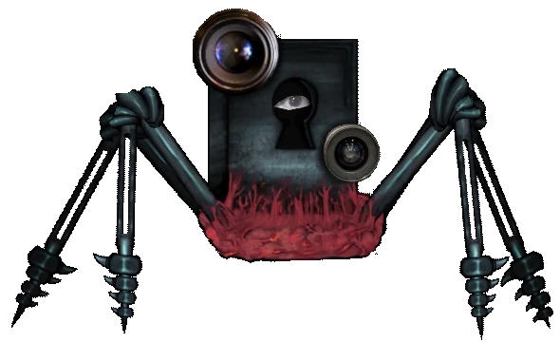
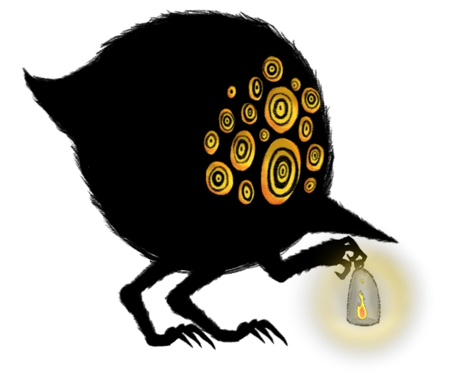
Themes: Perception (Seeing)
K, as Schadenfreude, is someone who wishes to look at others looking at him. Who derives pleasure from the attention and reactions others have to him, even if (and maybe especially) they are negative. His gaze is a purely selfish one, filled with greed and, perhaps, malice. After all, Schadenfreude is shown to attack those that look at it or otherwise cause them paranoia, implying that what it yearns for is fear and disgust.
Vik, as Big Bird, is someone who watches over and gazes at others to judge, as an expression of a distorted and misguided form of protectiveness and love. They wish to keep others safe from danger at all cost, even if it means harming others and themself. Their gaze is for the sake of others. After all, Big Bird's eyes are what it uses to find and dazzle those it seeks to protect, misguidedly believing that killing them saves them from a beast doing the same.

Slide 4
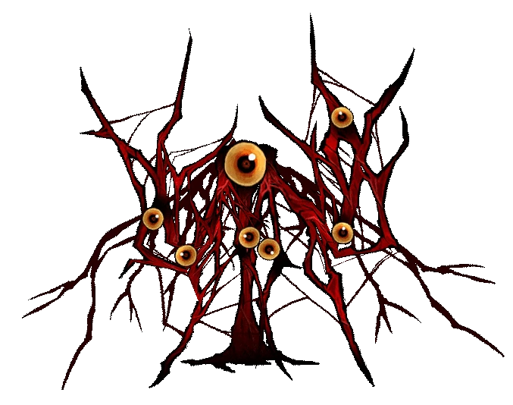
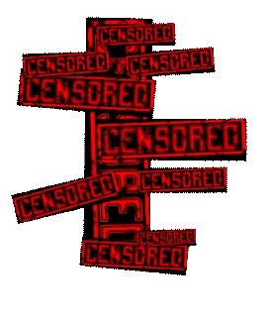
Themes: Perception (Being Seen)
K, as the Burrowing Heaven, is someone who feeds on the gaze of others and desires it more than anything else. They wish to be contained in someone's sight, for all attention and focus to be put on them. They live in the eyes of others. And, just like the Burrowing Heaven, they will do anything to reach that goal, of being gazed at.
Vik, as CENSORED, is someone who cannot truly be seen without causing mental corruption within those who see them. A sight so disgusting and dreadful, yet one that encapsulates the sacrifices required to survive. CENSORED is a representation of the ugliness that necessitates humanity and convenience, of the sacrifices that power the world itself.

Slide 5
Themes: The Intersection
In a way, K and Vik could not be more different in how they approach the themes of Perception. K is one that watches for his own gain, while Vik is one that watches for the sake of others. K is one that has to be seen to survive, while Vik is one that cannot be seen lest others be driven mad.
And yet, in a way, their respective themes fit in with each other like puzzle pieces. For if Vik and K were to gaze at one another, they would fulfill each other’s needs perfectly.
Vik containing K within their sight is a gesture that would protect K and allow him to survive and live on within their gaze. So many eyes willingly on him for his own sake. But, this connection is an easy and obvious one to make, you see.
It's when K's gaze towards Vik is examined thematically does the intersection truly become compelling. CENSORED, a being whose nature is filled with so much disgust and violence that humanity cannot bear to see it. Schadenfreude, a being whose nature is to seek out and greedily watch that what is filled with disgust and violence. Would the former not feel gratified to not only be seen for what it is, but to also be appreciated, nay, desired, for its nature?

Slide 6
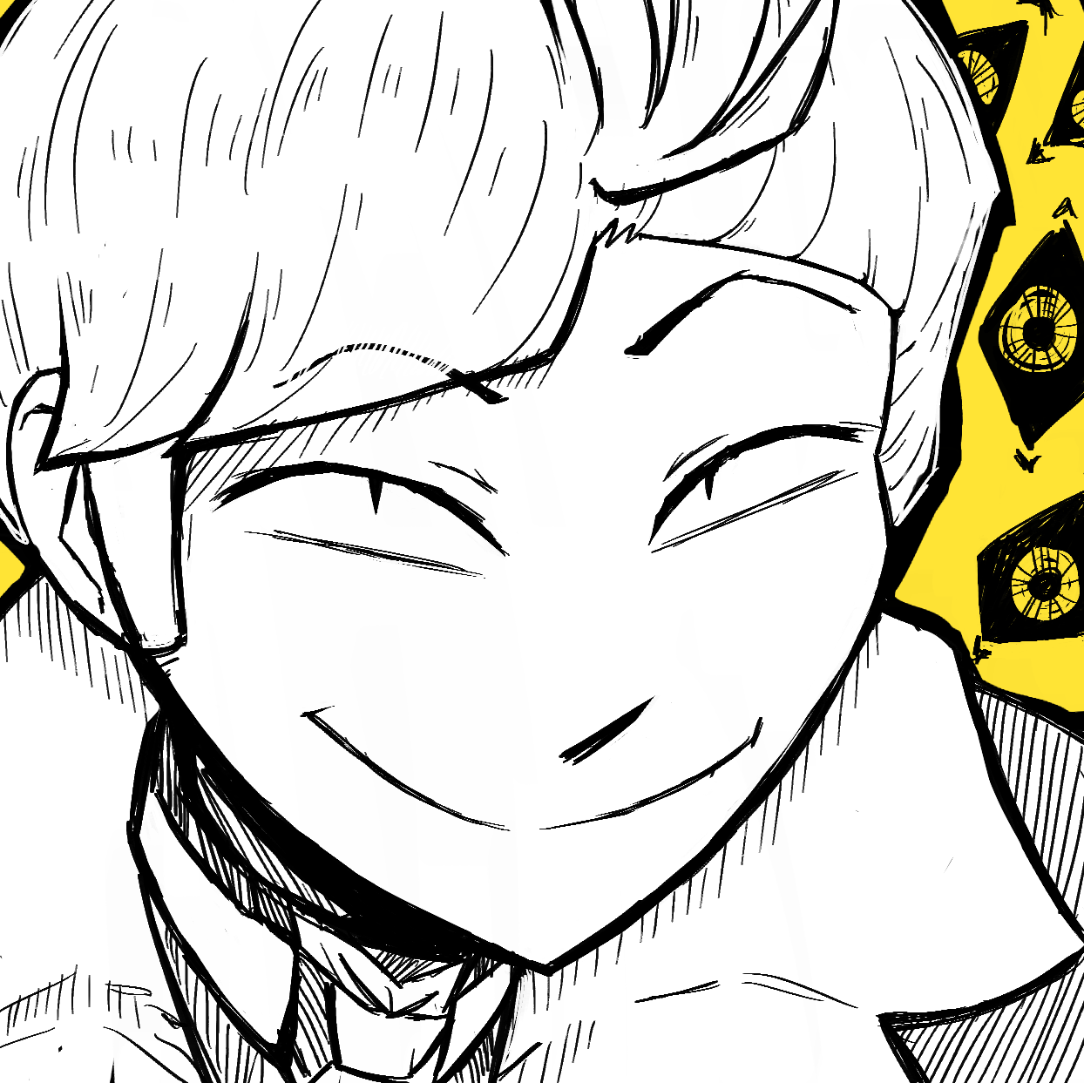
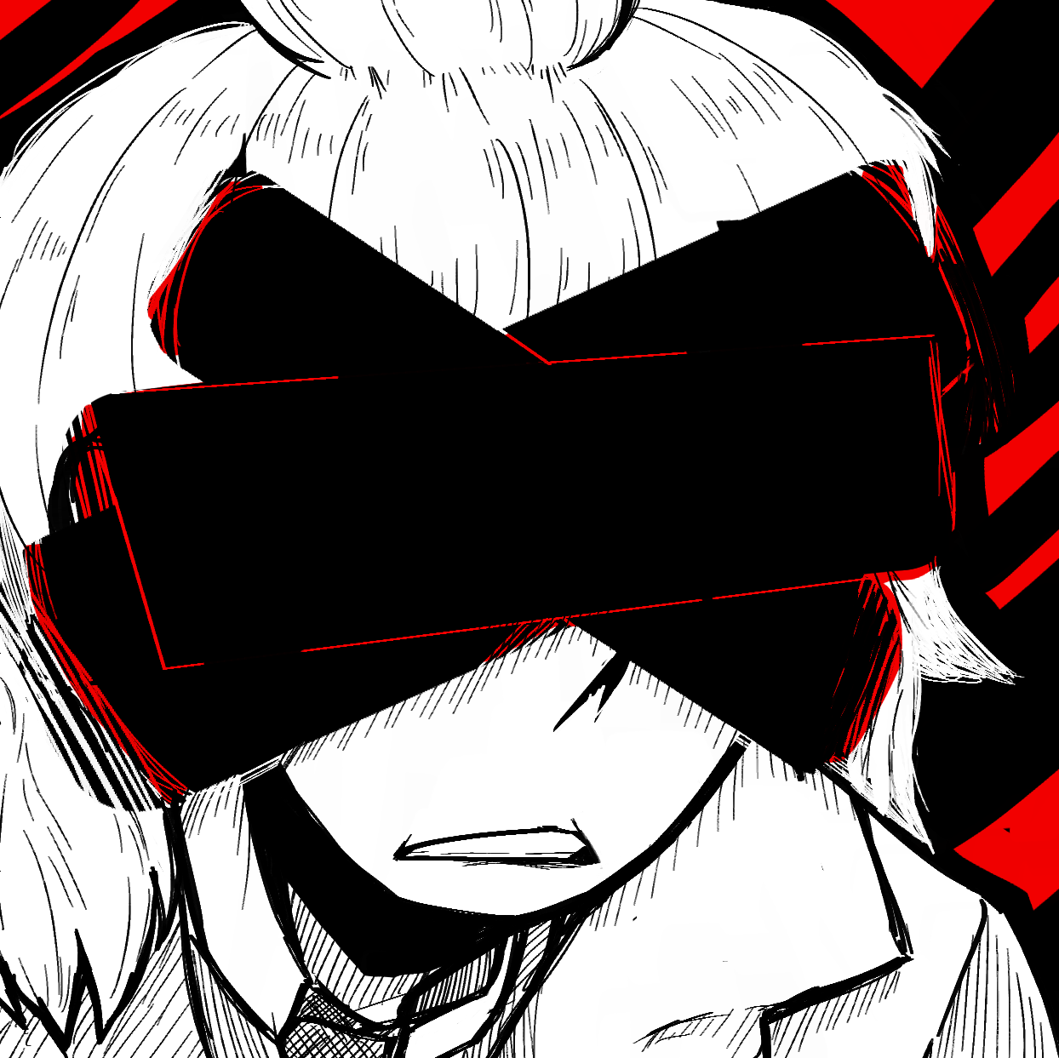
Personalities: Freaks (Affectionate)
Khana is a gremlin asshole. It's not even a secret. He's a selfish prick that gets offended at what he believes to be slights towards him, yet does not care about whether or not he does shit like that to others. Attention whore of a thing. Fucker would Love causing drama and being in the middle of it all.
Viktor is also a gremlin asshole, though one that doesn't show it outwardly. They are filled with so much rage in their tiny body, my god. Parker was right when he said they're like a cat. Normally they can manage to be polite (enough) and act aloof, but when they get going they're a fucking chaos goblin that would bite at ankles for no reason other than entertainment.

Slide 7
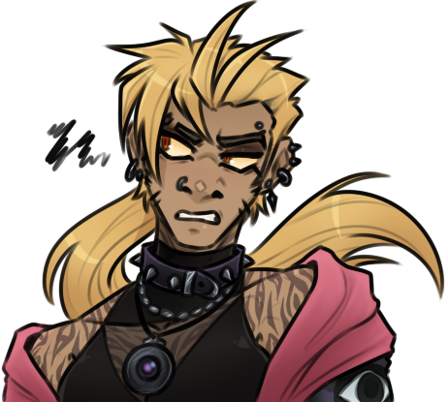
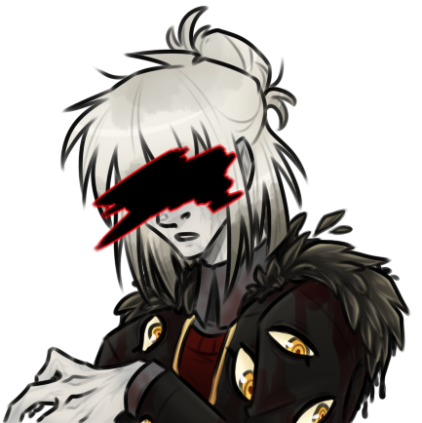
Personalities: Dependency (Contrast)
Khana fancies themself as a leader, the center of attention, a figure of authority that refuses to be defied. And yet, they are Oh So Desperate, willing to grovel and bite and scream just to be looked at, to be of importance, to be someone. A person that wishes more than anything to be seen as independent, and yet is so dependent on others they literally cannot live without another’s gaze.
Viktor is, perhaps, the most dependable motherfucker in this mall. Actually responsible and actively caring, if maybe not always in the best way. At the same time though, good lord are they tired. If only they could just stop giving a fuck and go a little apeshit, wouldn’t that be nice? It is part of why they and Parker ended up such good friends after all, since they can still let their genuine care for him shine without having to constantly worry about him.

Slide 8
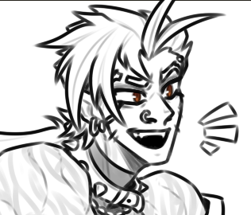
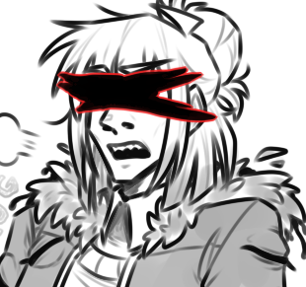
Personalities: The Interaction
They're both gremlin assholes. They're perfect for each other. /
Vik around Khana could relax and let themself be a little edgy, as a treat. K would be the perfect spectacle for Viktor to chow down on some popcorn to. They'd both go to Reddit to laugh at morons, together.
It also feels like the way the two could depend on each other without feeling the need to actively acknowledge it would be something that's nice for both of them. Khana loves feeling independent, and Viktor is more than willing to sit back and not have to worry if they can manage. At the same time though, when push comes to shove, Vik has more than enough care to share with K when the latter has no choice but to depend on someone else.

Slide 9
Relationship: Moirails (Understanding)
It's that inherent sense of reliability, that idea that they're capable of having each other's back, that makes me feel like their relationship could be pushed in a moirallegiance-like direction.
Vik is there for those moments when Khana needs someone at his side. Their eyes always willing to turn and capture him in their gaze when there's no one else to stop him from falling and spiralling. Even if he himself would never admit it out loud.
K is more than happy to give Viktor the space they need to rest. Take up the responsibility and be the face in charge if they ever wish to retreat to the shadows for a moment. Let the gaze on them be transferred to him, and let his own gaze be a stand in for their own.

Slide 10
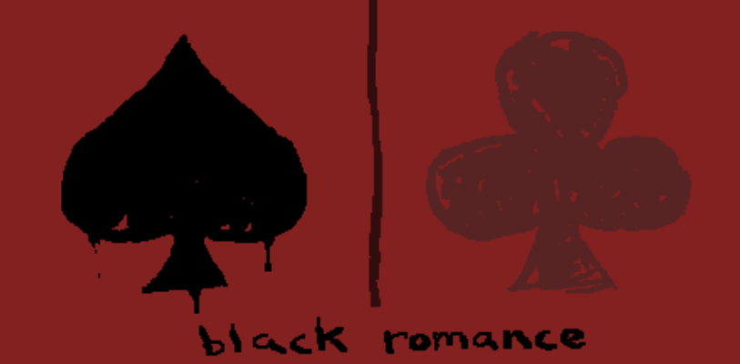
Relationship: Blackrom (Trust)
That being said, there's no way this could ever be a straight-forward moirallegiance. Like I mentioned before, they're both gremlin assholes, and I feel like a blackrom-leaning relationship between them would be a decent outlet for their assholery. A safe space for insults and mild violence, where the two trust each other enough to know the quarreling doesn't affect their bond.
The best way I can describe this potential side of their ship is that one Trollian log, where Karkat and Sollux bicker and call each other names for the whole log, only to go "hey, we're still friends and chilling" "yeah, of course" by the end. It's that reliability combined with being able to be absolute pricks towards each other that I find compelling.

Slide 11
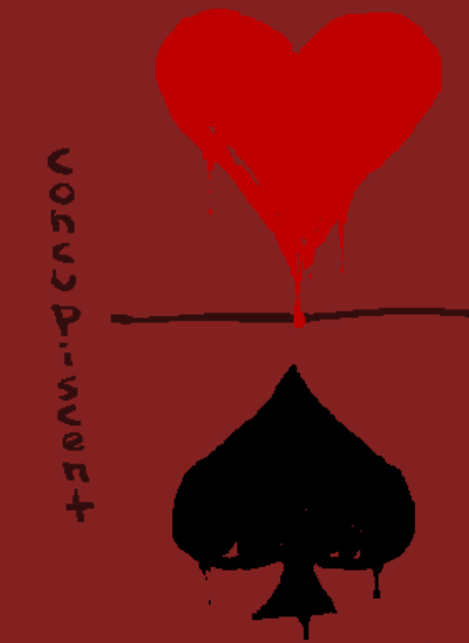
Relationship: Concupiscent (Carnal)
But I can't just end there. No, I believe there's one more ingredient that transforms this from a mere dynamic to a full on ship. The sensual side.
It's one thing for Vik to have someone who is able to tolerate being near them, to be able to look past the disgusting and revolting due to his own filth so that a Friendship can bloom. But what if that disgusting and revolting part of them wasn't just tolerated, but desired? What if the part of you that you had to hide for the sake of appearing normal was the very thing someone found appealing?
And then there's K. There's a lot of superficiality to many of his relationships. The lies, the one night stands, the LookAtMe behavior, all for the sake of being seen. So what if the desperate didn't need to try? Didn't need to be superficial to become the object of someone's gaze? To be held, and contained, and bitten, and the center of attention, not thanks to the mask you wear, but because you're stripped bare to what you truly are.

Slide 12
Mildly NSFW Interlude: Why I Find It Important That These Two Freaks Desire Each Other Carnally
They're fucking because I think they should be fucking. Gay sex might not fix them, but by Wings it can't make them any worse. Hope this helps. /
On a more serious note, this more intimate setting for both Vik and K has a lot of potential for both of them to be able to bare their true selves towards each other without feeling the need to hide anything just to be seen. Vik can be as revolting as they feel like being, because that's what K finds attractive about them. K doesn't have to act for crumbs of attention, because Vik is keeping their gaze on him out of their own desire.
Of course, there's likely to be a question lingering in the air because of that explanation: why not just translate this unconditional intimacy into romance instead? Simply put, I don't think K nor Vik are people who'd want that kind of relationship. Vik strikes me as someone too tired to maintain such a high-effort bond, and K is, well, K. Even if my musings that K is alloaro aren't canon, he doesn't strike me as someone with the emotional honesty necessary to have a healthy romantic bond.
Turning that intimacy into one that is more sexual gives it the ability to maintain that theme while not having to include the parts of romance that would get in the way of such a unique relationship. Plus, with kink there are certain boundaries that the two can set that would not work as well if the bond was just romantic.
That being said, K being a bottom and getting topped by Vik would fix him. /

Slide 13
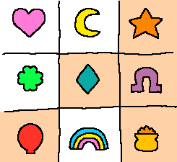
Charms: Allow Me To Pretend I Understand Them
Because it wouldn't be proper Zampanio ship discourse without using Charms. So, allow me to try and explain my VikK vision with them.
I'd say their initiation would be star-coded if anything. The jokes they share, the flame wars they'd get with each other on Reddit, the insult exchanges, the closest analogue to all that I'd say is japes, so that's where we're starting.
Then, we get our horseshoes moments. The perfect fit of their Abnormality affinities, their corresponding attachments to perception, and of course the one in a million chance of K realizing that he's into whatever Vik has got going on are all very lucky gambits.
This is where the otherwise perfectly right-leaning relationship gains its left-leaning diagonal. As Vik and K gain better understandings of each other, the affection starts showing. The laughter and assurances after insult wars, the reliable gazes being sent each other's way. I believe we've got some diamonds going on in here for sure.
That's where we finish the diagonal. The genuine care that forms between the two despite the extremely right-leaning overtones is staggering. The closest way I can describe this is an aromantic balloon. Their love is unconventional and absolutely not romantic, and yet it's one they can depend on when they need it most.
That all being said, the trove is a full leaning upward V. Or would it be called a ^? I mean, hell, their most intimate and intense moments rely on them being able to discard the masks they were so used to wearing! If that's not a form of pot-of-gold reversal of fortunes I don't know what is.

Slide 14
Why They Matter: I Think I Hauve Couvid
Even before my first death, the dynamic between Vik and K was one I was desperate to see, and was seemingly consistently denied considering how many fics of their interactions were apparently scrapped. / ~ It's only after I came back, with my knowledge of their potential themes via Abnormality research deppened, that I began to notice the sheer potential these two could have.
Zampanio is a breeding ground for unconventional couples, the charms system being but one symptom of this fact. A relationship like the one I propose between Vik and K, one filled with support, care, intimacy, and asshattery, yet notably lacking in conventional romance, is one that would feel right at home. It's complex, it's weird, and it's something that only these freaks could come up with and do well with.
I mean, we've got so many of the corners of shipping covered. We've got the MLMs covered with NevyWibs, we've got the WLWs covered with CamiRia (or even FlowerCloser if you're fancy), and we've even got some MLWs with Captain's crush on Doc Slaughter. And this here is my personal answer for the NBLNB corner.
Please get these fuckers out of my head.
Seriously they won't leave.
That Burrowing Heaven Breach piece? Yeah that was actively made to have subtle VikK vibes.
It's so joever for me, the least I can do is spread the brainrot.

